Slide 1
Lab meeting
25/06/2019

Slide 2
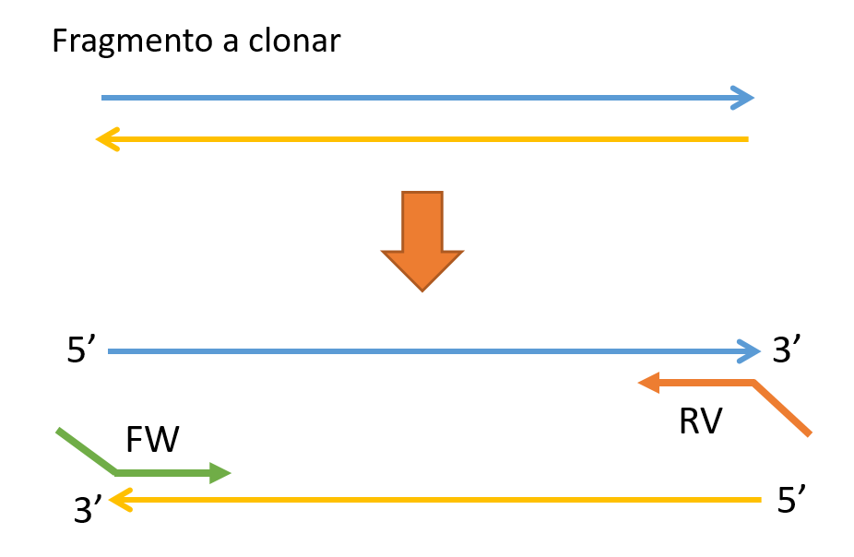
Cloning
Insert you want to clone

Slide 3


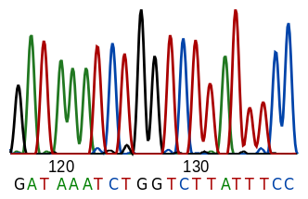

Slide 4
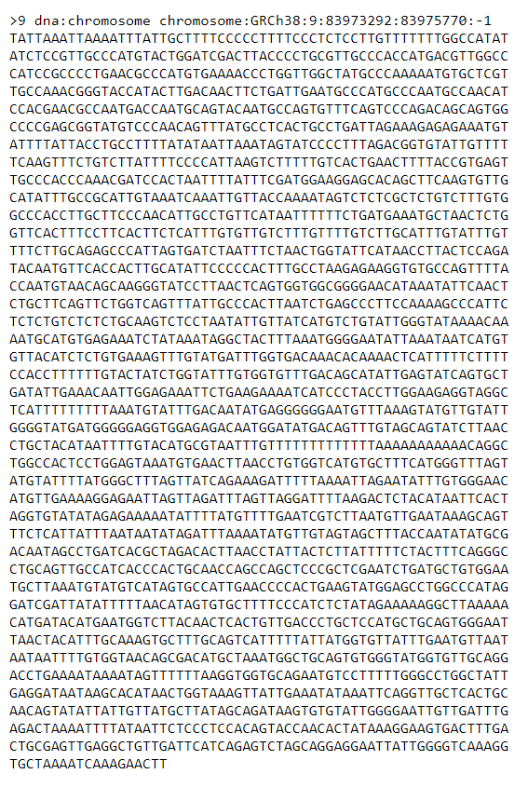
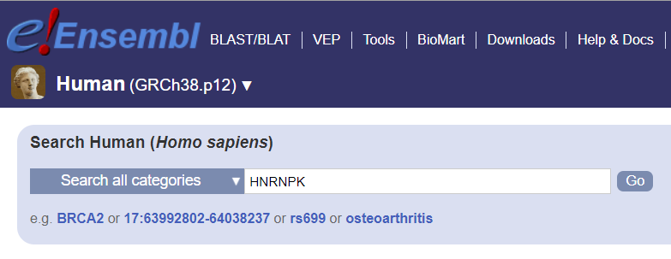
Primer design
Step 1: Find your sequence
IDE

Slide 5
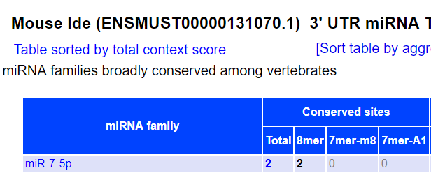
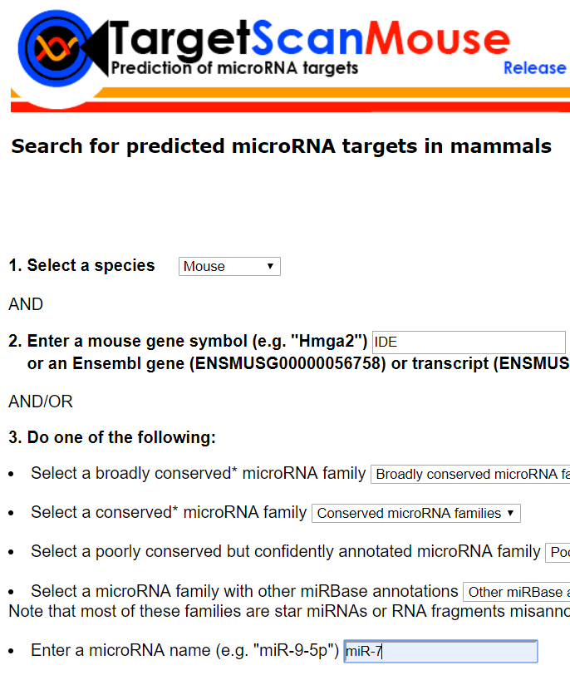
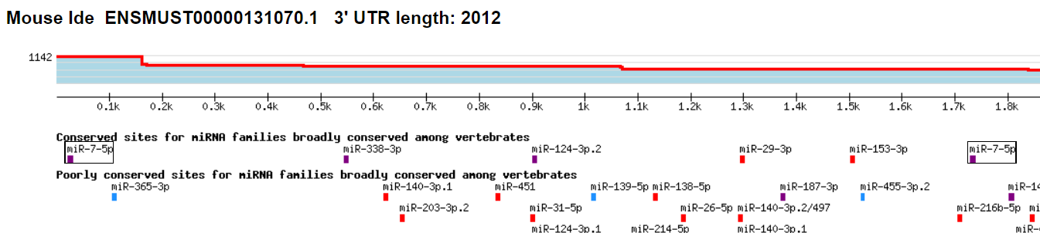
Primer design
Step 2: Find miRNA binding sites

Slide 6
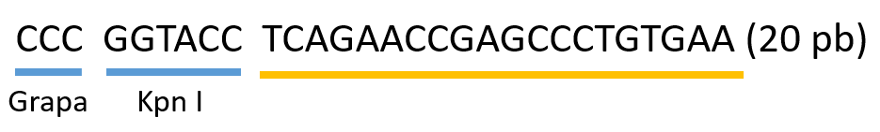

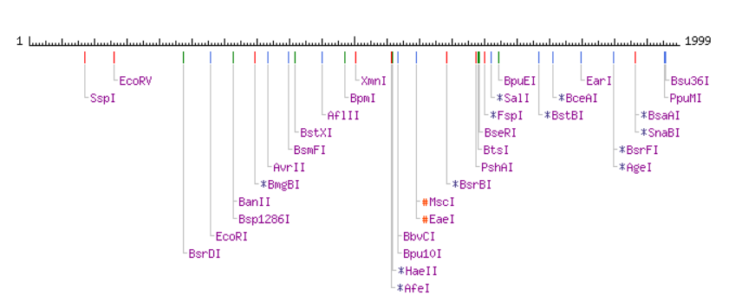
Primer design
Step 3: Design your pair of primers
Check for restriction endonuclease recognition sites in your insert

Slide 7
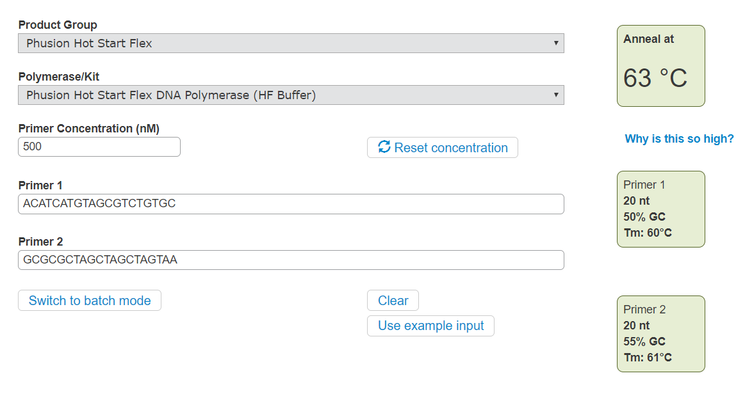
Primer design
Step 3: Design your pair of primers
Choose two sequences with similar melting temperatures (Tm)
%GC
polymerase
primer length

Slide 8
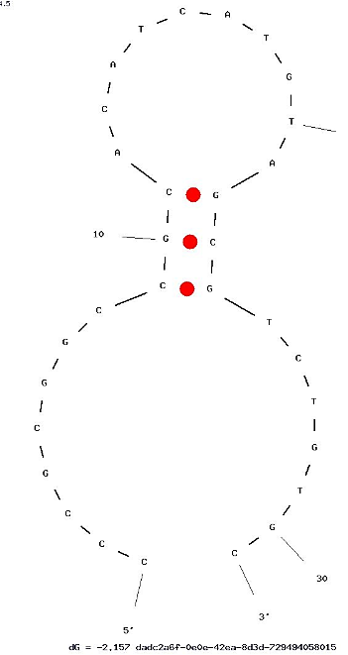
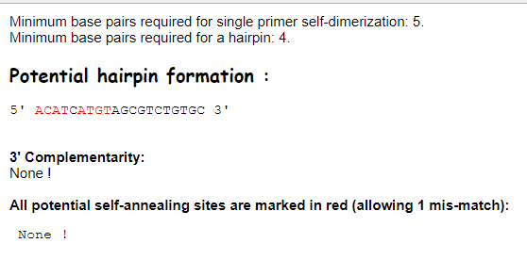
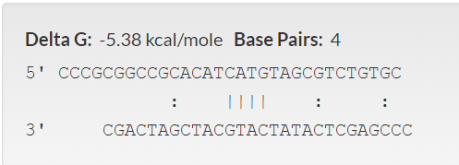
Primer design
Step 3: Design your pair of primers
Check for dimerization
Homodimers
Heterodimers
Hairpins
Homodimers
Heterodimers
Hairpin

